Slide 1

Food diet recommendations

Slide 2
ABSTRACT:
Your food choices each day affect your health — how you feel today, tomorrow, and in the future. Good nutrition is an important part of leading a healthy lifestyle. Combined with physical activity, your diet can help you to reach and maintain a healthy weight, reduce your risk of chronic diseases (like heart disease and cancer), and promote your overall health.
A balanced diet is one that gives your body the nutrients it needs to function correctly. The number of calories in a food is a measurement of the amount of energy stored in that food. Your body uses calories from food for walking, thinking, breathing, and other important functions.
The average person needs to eat about 2,000 calories every day to maintain their weight. However, a person’s specific daily calorie intake can vary depending on their age, gender, and physical activity level.
Men generally need more calories than women, and people who exercise need more calories than people who don’t

Slide 3
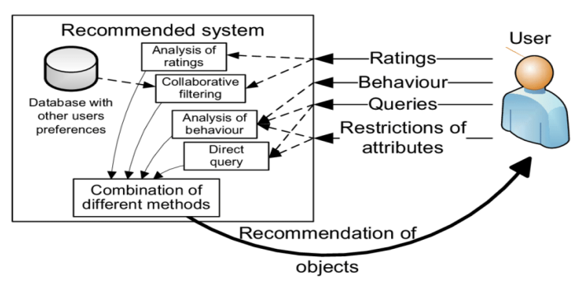
Recommded System
INTRODUCTION :
The recommendation process has basically three stages that are Information Collection Phase, Learning Phase and Recommendation Phase.
The information is firstly collected about a particular problem and the various solutions related to that problem are categorized. After the collection of information Learning Phase comes in which various conclusions are made out of that information which is gathered and in last phase i.e. Recommendation Phase an output is given in which various recommendations are made.
In our system since it is a diet recommendation system so the recommendations will be about the diet plan like what all things you should eat, what is your Body Mass Index, which states whether you are healthy, overweight, or under-weight.

Slide 4
Techniques used for building a Recommendation System

Slide 5
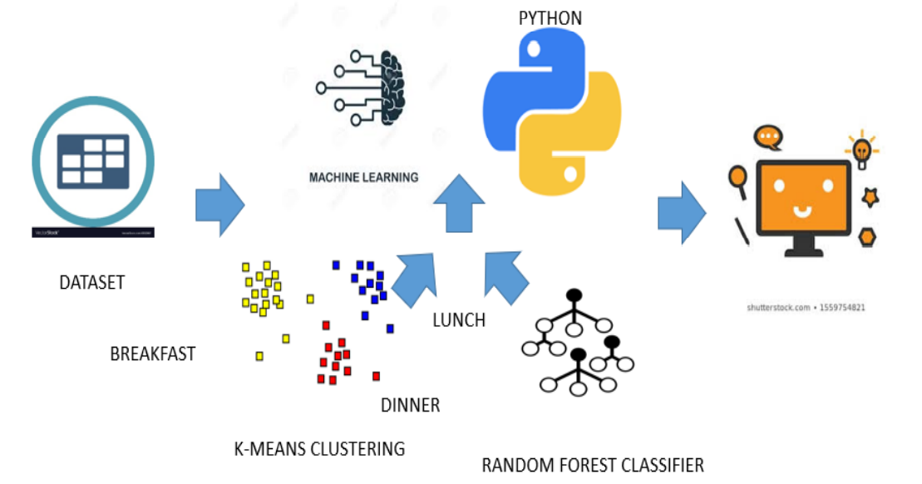
2.SYSTEM ARCHITECTURE:

Slide 6
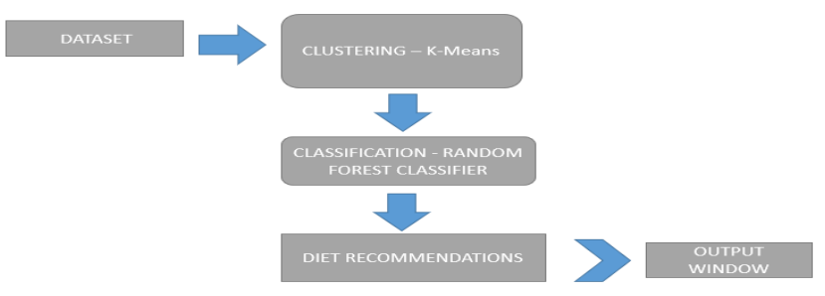
3. SYSTEM WORKFLOW:

Slide 7
4. PROPOSED WORK:
This project has been developed using Machine Learning algorithms. KMeans clustering was used to cluster the food according to calories and then Random Forest Classifier is used to classify the food items and predict the food items based on input given.

Slide 8
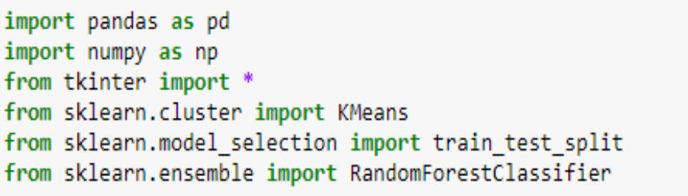
Header files used:
Pandas was used to read datasets.
Numpy was used to convert features into numpy and then perform the further operations.
Tkinter was used to create interface.
KMeans was used to perform clustering.
Train_test_split was used to divide the dataset into train and test portions to train and test the model.
RandomForestClassifier used to predict the food items based on clustered data.

Slide 9
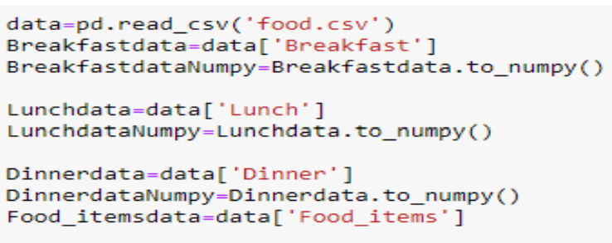
Reading the dataset:

Slide 10
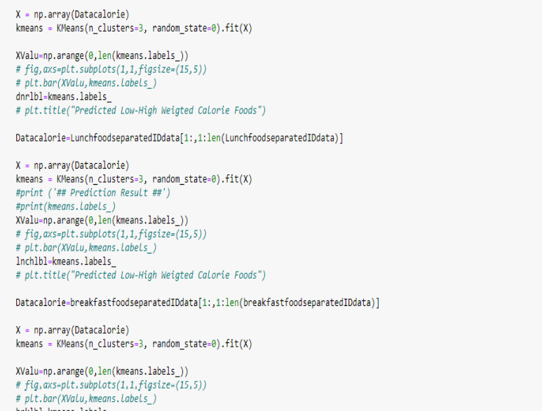
Applying KMeans for clustering on Lunch_data, Breakfast_data, Dinner data:

Slide 11
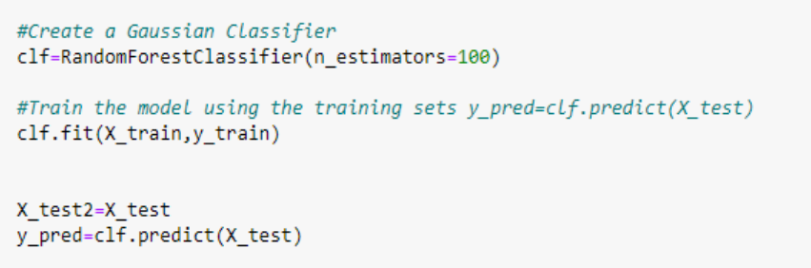
Applying Random Forest Classifier:

Slide 12
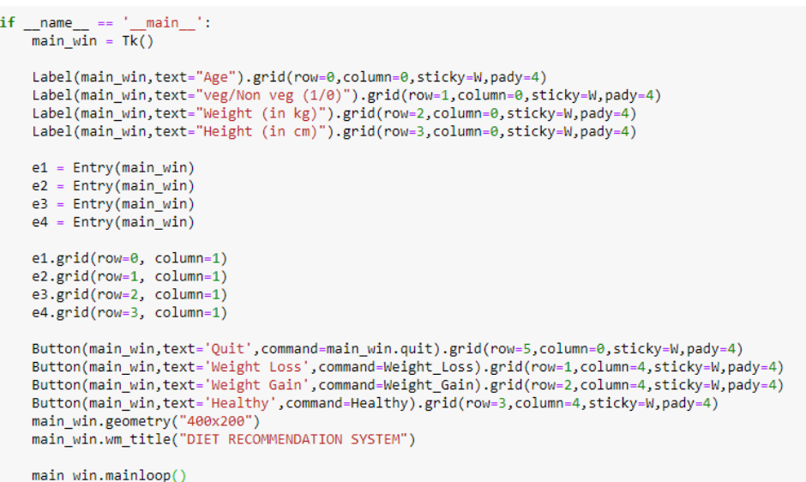
Creating Interface:

Slide 13
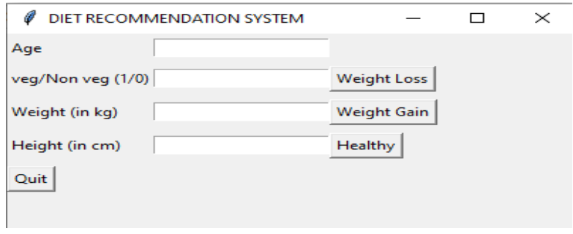
Taking Input:

Slide 14
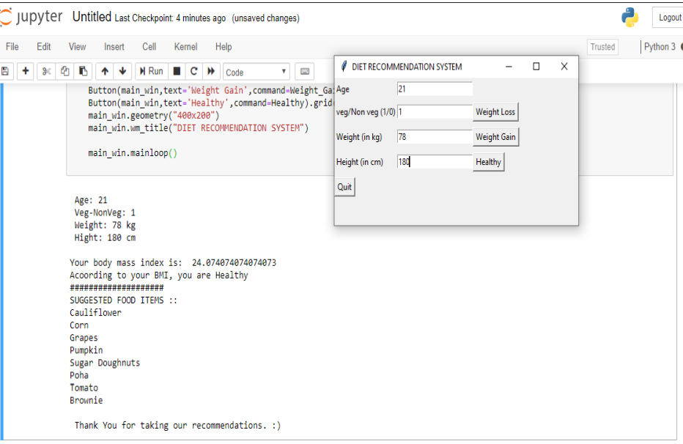
Predicting food items for Weight Loss Diet Plan:

Slide 15
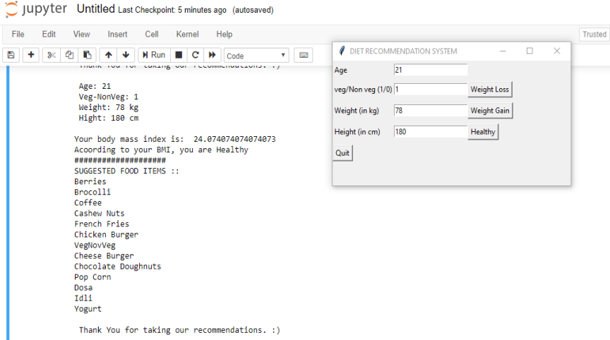
Predicting Food Items for Weight Gain Diet Plan:

Slide 16
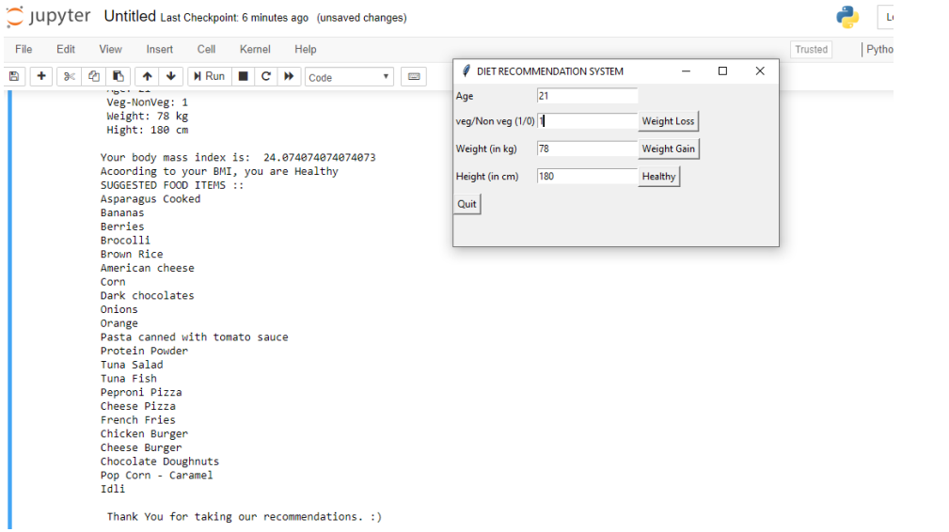
Predicting Food Items for Healthy food items:

